Slide 1
Micro python weather station using ESP32
Akshaya K B
CB.EN.P2EBS22001

Slide 2
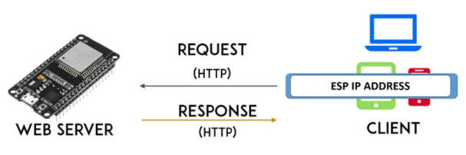
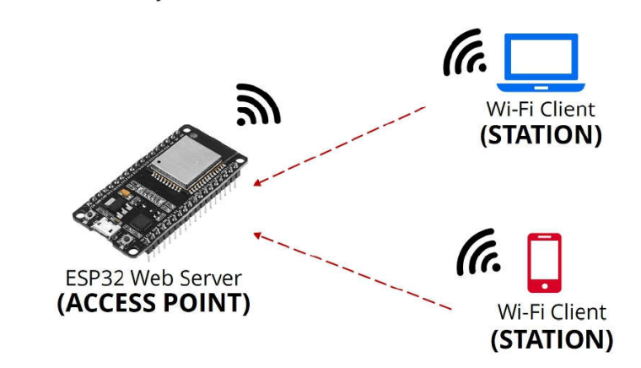
Block Diagram
ESP 32 WEB SERVER

Slide 3
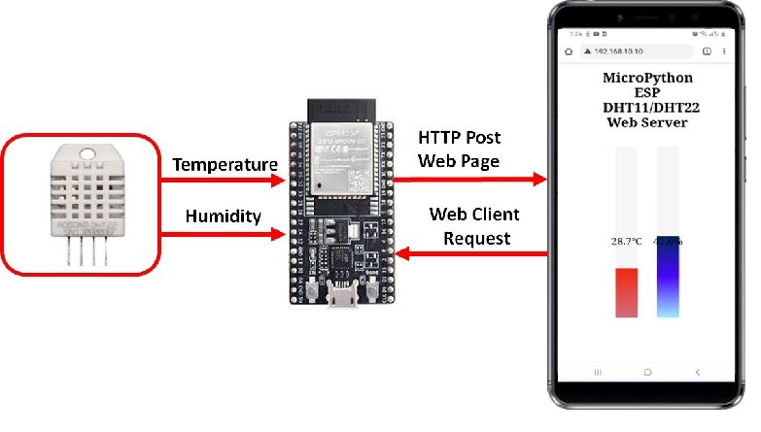
Web Server

Slide 4
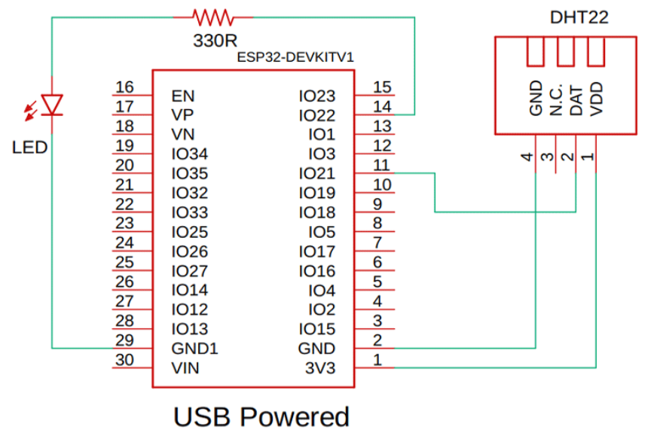
Hardware Connection

Slide 5
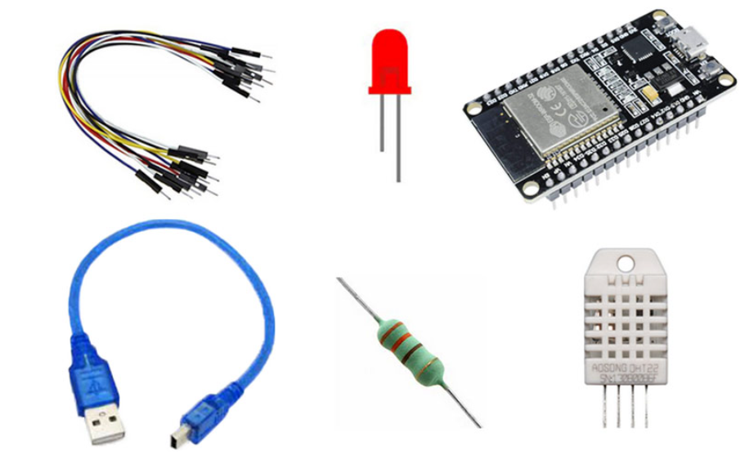

Components
ESP32-DevKit
DHT11 –temperature and humidity sensor
Jumper Wires
USB cable
SOFTWARE:
Thonny IDE

Slide 6
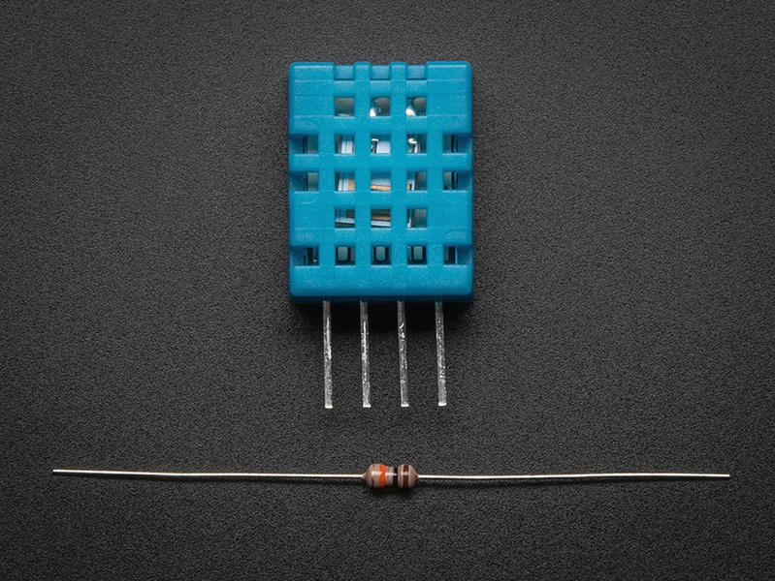
DHT 11 Sensor
3 to 5V power and I/O
2.5mA max current use during conversion (while requesting data)
Good for 20-80% humidity readings with 5% accuracy
Good for 0-50 °C temperature readings +-2 °C accuracy
No more than 1 Hz sampling rate (once every second)
COURTESY: https://shop.evilmadscientist.com/productsmenu/716

Slide 7
Micropython
MicroPython is a lean and efficient implementation of the Python 3 programming language that includes a small subset of the Python standard library and is optimised to run on microcontrollers and in constrained environments.
ESP32 runs MicroPython on the bare metal, gives low-level Python operating system that can be used to control all kinds of electronic and iot projects

Slide 8

ESP 32

Slide 9
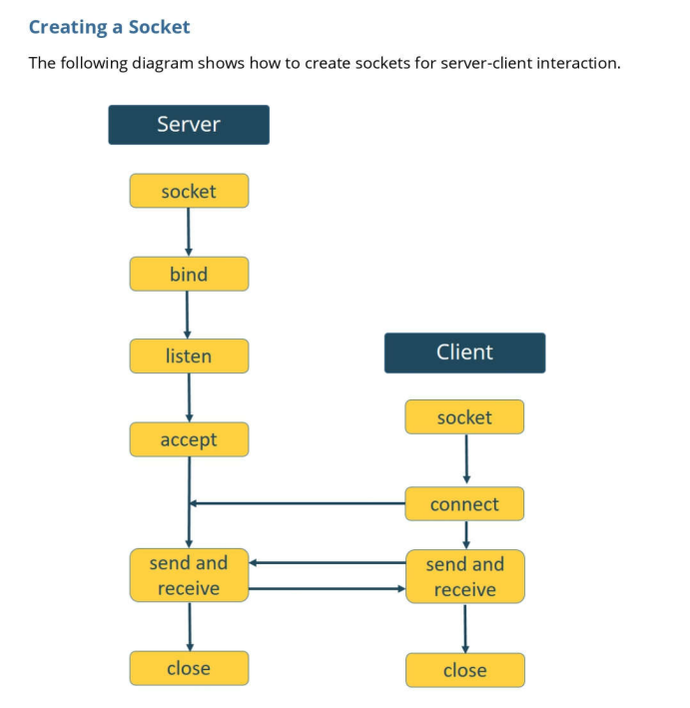

Slide 10
Description
ESP-based web server: It runs on Simple HTTP requests and requires to complete refresh of the webpage in order to get any updated data.
Socket is used in client-server applications
Sockets and socket API are used to send messages across a network
WebSocket communication protocol: It will notify all the clients when changes occur and the webpage will be updated instantaneously using AJAX.

Slide 11
What is AJAX?
AJAX = Asynchronous JavaScript And XML.
It is not a programming language.
It just uses a combination of:
A browser built-in XMLHttpRequest object (to request data from a web server)
JavaScript and HTML DOM (to display or use the data)

Slide 12
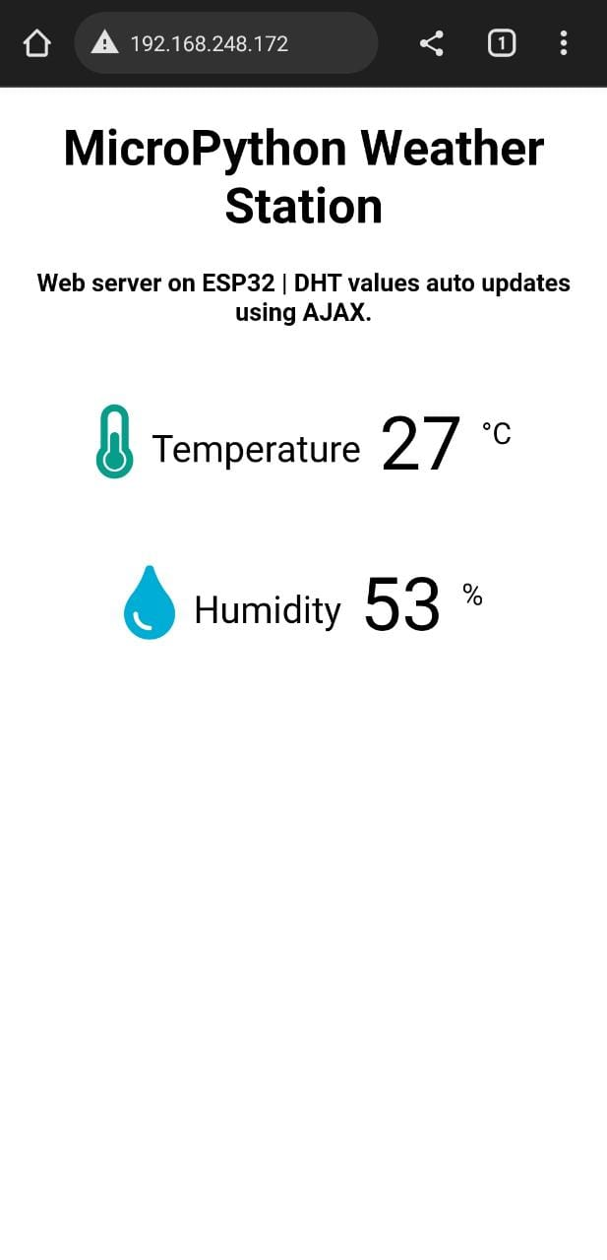
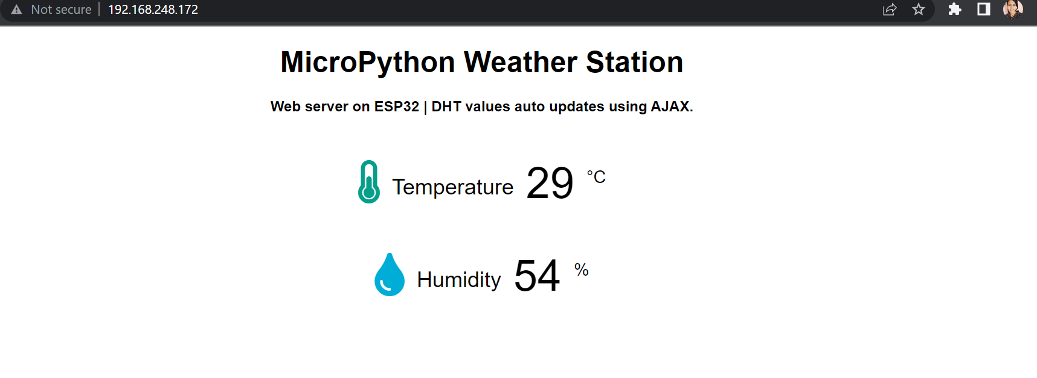
Output
Client 2
Client 1

Slide 13
Thankyou!

